Slide 1
W.A.S.P.
By Ralfs Zangis
& Birta Andrei
Notes:
A(slide 1): Hello and welcome to group’s number 2 presentation for this semester’s exam. In the following 50 minutes, we are going to talk about (slide 2) who we are, what we did and how we did it.

Slide 2
Presentation Plan
Who we are
What we did
How we did
QNA

Slide 3
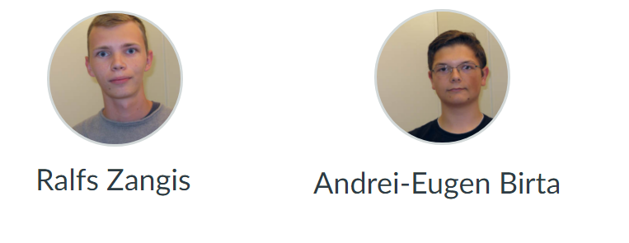
Who are we?
Notes:
A(slide 3): So, who are we? My name is Birta Andrei and he is Ralfs Zangis. (play animation) Together we united in order to fight against the forces of evil, and make a project.

Slide 4
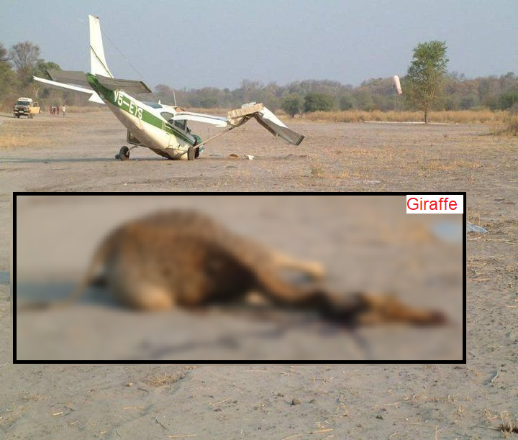
What did we do?
Wildlife
Aircraft
Strike
Project
Notes:
A(slide 4): But what is the project about? Well, just as the name might suggest, within the pales of this project we wanted to try and reduce, if not fully stop any and all accidents (play animation) that might happen in the future, regarding aircrafts and wildlife within the territory of the United States of America.

Slide 5
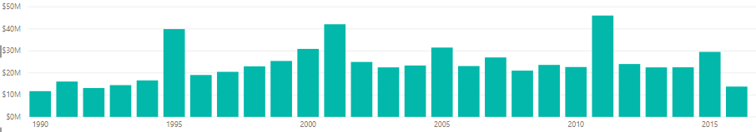
Why this subject and not something else?
142.921.417 total flights 2009-2017 in the USA
86.877 strikes 2009-2017 in the USA
0.06% collision rate in the USA
532 million US$ (457 million euros)
Notes:
A(slide 5): Why this and not some other subject? Because, although in the period of 2009-2017 from all 142.921.417 flights in the USA, there have been 86.877 collisions with wildlife, giving us a 0.06% chance of collision; We thought that this case is quite important as the lives of those unfortunate enough to witness a crash, are changed forever. It also costed companies in the USA around 532 million$; Not to mention the 30 people that died and 265 injuries and distrust that such an event will cause in the airlines customers.

Slide 6
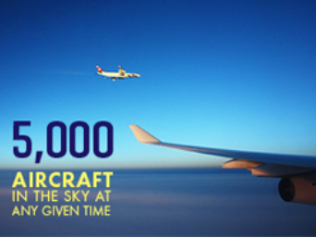
Why this subject and not something else?
48.000 average flights per day
Number taken from FAA (Federal Aviation Administration)
Notes:
A(slide 6): And considering there are around 5000 aircrafts in the sky, at any given moment, and an average of 48.000 flights per day; that gives us around 29 collisions per day. So we thought: “how can we make sure that those will not partake into any accident?”; So this project came to life.

Slide 8
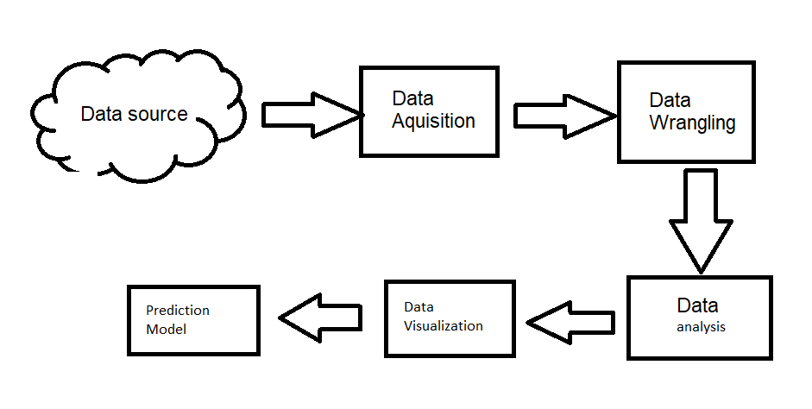
How are we reducing the number of collisions?
Notes:
A(slide 7): How are doing that? Well, we couldn’t do anything, before learning some more about the case. So we thought of some data that might help us, found the data we though is going to help us from a reliable source, we acquired it, we cured it, analyzed it, visualized it and in the end, created a prediction model.

Slide 9
How is all that stuff, reducing the collision rate?
Educating
Predicting
Prescribing
Notes:
A(slide 8): But how exactly is all of that reducing the collision rate? Our entire project, is reducing the collision rate through multiple ways:
by educating the uninformed about the matter, through the descriptive and diagnostic analysis’s we did;
by offering a prediction model, which uses both supervised and unsupervised machine learning techniques, in order to predict whether a flight is going to or not partake into a collision with any wildlife.
by offering some guidelines and examples of successfully proven ways of reducing such collisions from happening, used by multiple airports in the USA.

Slide 10
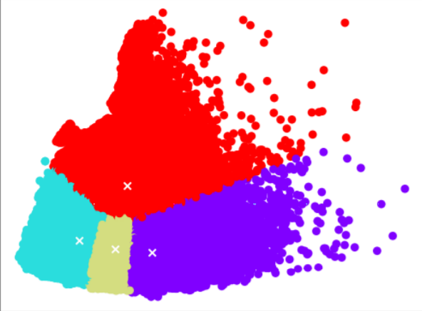
What about that Prediction Model, how does it work?
Unsupervised (K-means)
Supervised (decision tree)
Notes:
combination
k means, data refining(click)
how: clusters (elbow analysis)
why: clusters

Slide 11
How does the model make a decision?
Supervised learning (decision tree)
Accuracy:
99.55% (combined)
99.53% (tree only)
Notes:
decision tree
Accuracy
Show decision tree

Slide 12
How did we manage to achieve this?
Development framework: Kanban
Total working time: ~500 hours (combined)
Notes:
A(slide 11): Now you may ask yourself: how did we manage to achieve this? We did it by following a development framework called: Kanban; we did it by investing around 500 hours of working time (combined), most of which went into researching the matter, as we knew little to nothing about it, before dwelling into it, and another big chunk of time went into cleaning the data as we had to deal with NA values and misspellings and what not.

Slide 13
Data Wrangling
Identifying Missing Values
Handle N/A
Data Formatting
Data Normalization
Notes:
pyhton numpy pandas sklearn
started by reviewing data
determined nan values
mode mean median or removing
correct format (datime instead of string)
normalized values (airport in date)
15 ways of spelling weather description
Saved as .csv

Slide 14
The End?

